Slide 1
Project Management & Information Technology
Chapter 2
Information Technology Project Management, Seventh Edition

Slide 2
Learning Objectives
Describe the systems view of project management and how it applies to information technology (IT) projects
Understand organizations, including the four frames, organizational structures, and organizational culture
Explain why stakeholder management and top management commitment are critical for a project’s success

Slide 3
Learning Objectives
Understand the concept of a project phase and the project life cycle, and distinguish between project development and product development
Discuss the unique attributes and diverse nature of IT projects
Describe recent trends affecting IT project management, including globalization, outsourcing, virtual teams, and agile project management

Slide 4
Projects Cannot Be Run In Isolation
Projects must operate in a broad organizational environment
Project managers need to use systems thinking
Senior managers must make sure projects continue to support current business needs

Slide 5
A Systems View of Project Management
A systems approach emerged in the 1950s to describe a more analytical approach to management and problem solving
Includes:
Systems philosophy
Systems analysis
Systems management

Slide 6
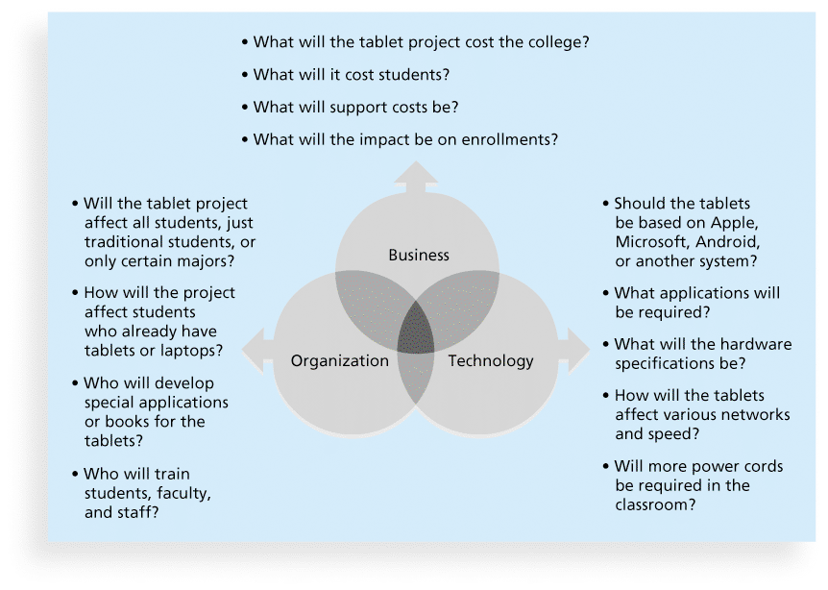
Three Sphere Model for Systems Management

Slide 7
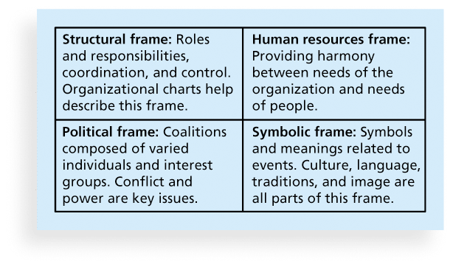
Perspectives on Organizations

Slide 8
What Went Wrong?
In a paper titled “A Study in Project Failure,” two researchers examined the success and failure of 214 IT projects over an eight-year period in several European countries.
The researchers found that only one in eight (12.5 percent) were considered successful in terms of meeting scope, time, and cost goals.
The authors said that the culture within many organizations is often to blame
Among other things, people often do not discuss important leadership, stakeholder, and risk management issues

Slide 9
Factors Influencing IT Project Management
Organizational Structure
Organizational Culture
Top Management Commitment
Stakeholder Management
Commitment to IT
IT Governance/Organizational Standards

Slide 10
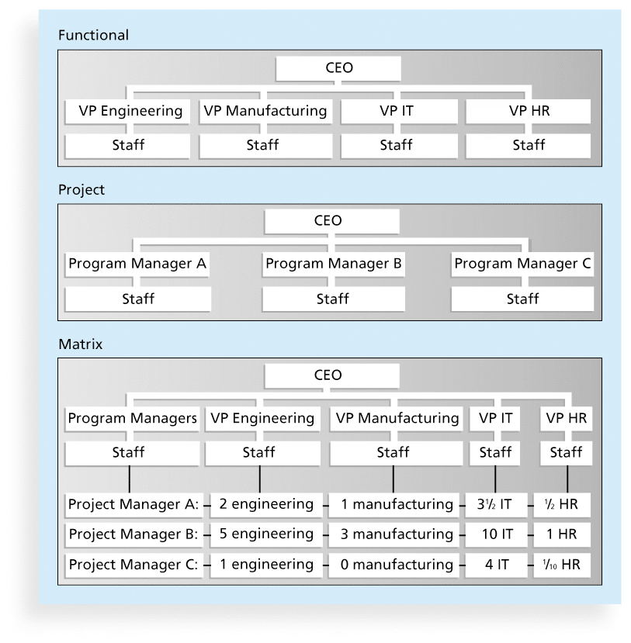
Organizational Structures
3 basic organization structures
Functional
Project
Matrix

Slide 11
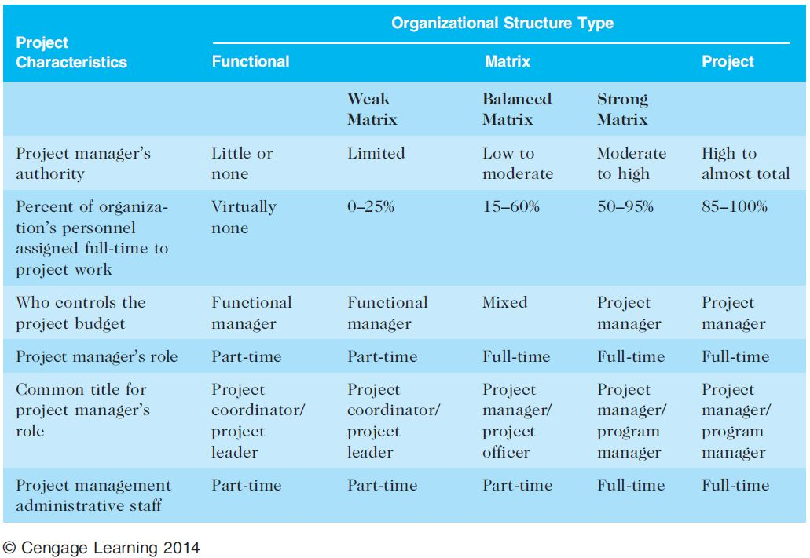
Organizational Structure Influences on Projects

Slide 12
Organizational Culture
Organizational culture is a set of shared assumptions, values, and behaviors that characterize the functioning of an organization
Characteristics of Org. Culture
Risk tolerance*
Reward criteria*
Conflict tolerance*
Means-ends orientation
Open-systems focus*
Member identity*
Group emphasis*
People focus
Unit integration*
Control

Slide 13
Top Management Commitment
People in top management positions are key stakeholders in projects
A very important factor in helping project managers successfully lead projects is the level of commitment and support they receive from top management
How does Top Management help a project?

Slide 14
Stakeholder Management
Project managers must take time to identify, understand, and manage relationships with all project stakeholders
Using the four frames of organizations can help meet stakeholder needs and expectations
Who is often considered one of the most important stakeholders?

Slide 15
Organizational Commitment to IT
If the organization has a negative attitude toward IT, it will be difficult for an IT project to succeed
Having a Chief Information Officer (CIO) at a high level in the organization helps IT projects
Assigning non-IT people to IT projects also encourage more commitment

Slide 16
IT Governance / Standards
IT governance addresses the authority and control for key IT activities in organizations, including IT infrastructure, IT use, and project management
Standards
PMO or simply having templates/forms
Example: Texas Tech IT PM Standards

Slide 17
Project Phases and the Project Life Cycle
A project life cycle is a collection of project phases that defines
what work will be performed in each phase
what deliverables will be produced and when
who is involved in each phase, and
how management will control and approve work produced in each phase
A deliverable is a product or service produced or provided as part of a project

Slide 18
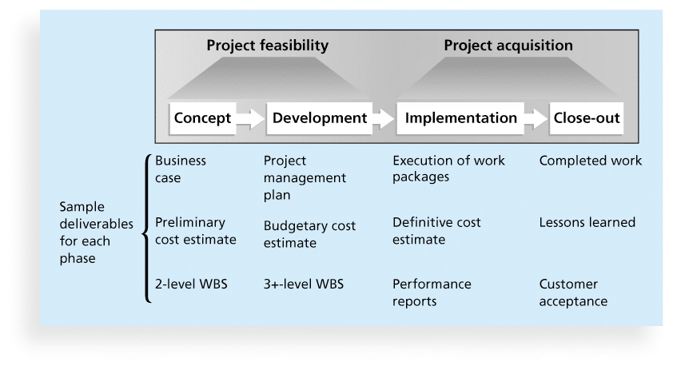
Phases of the Traditional Project Life Cycle

Slide 19
Product Life Cycles
The Systems Development Life Cycle (SDLC) is a framework for describing the phases involved in developing and maintaining information systems
Systems development projects can follow
Predictive life cycle
Adaptive Software Development (ASD) life cycle

Slide 20
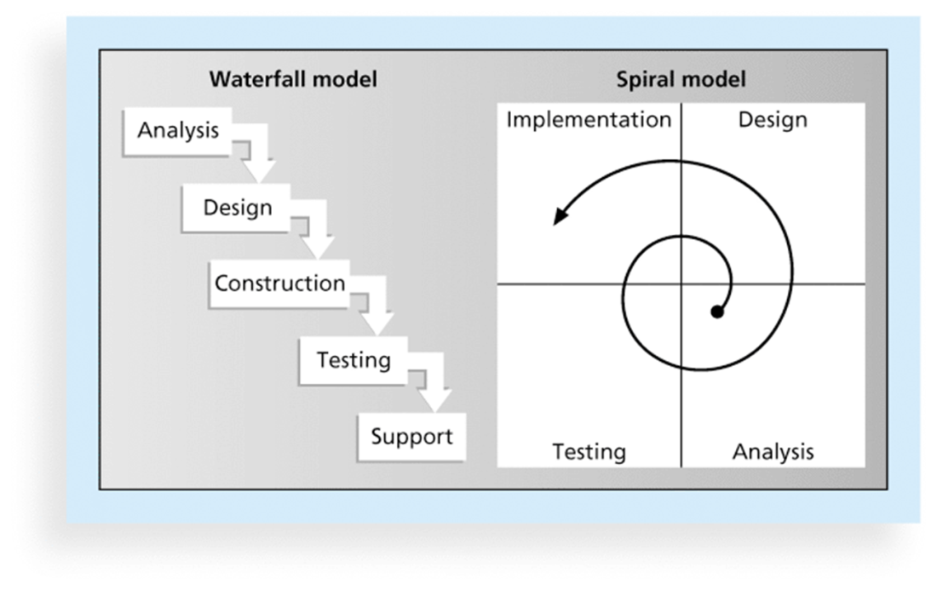
Examples of Predictive Life Cycle Models
Waterfall model
Spiral model
Incremental build model
Prototyping model
Rapid Application Development (RAD) model

Slide 21
Agile Software Development
Agile software development has become popular to describe new approaches that focus on close collaboration between programming teams and business experts

Slide 22
The Importance of Project Phases and Management Reviews
A project should successfully pass through each of the project phases in order to continue on to the next
Management reviews, also called phase exits or kill points, should occur after each phase to evaluate the project’s progress, likely success, and continued compatibility with organizational goals

Slide 23
What Went Right?
"The real improvement that I saw was in our ability to⎯in the words of Thomas Edison⎯know when to stop beating a dead horse.…Edison's key to success was that he failed fairly often; but as he said, he could recognize a dead horse before it started to smell...In information technology we ride dead horses⎯failing projects⎯a long time before we give up. But what we are seeing now is that we are able to get off them; able to reduce cost overrun and time overrun. That's where the major impact came on the success rate.”*
Many organizations, like Huntington Bancshares, Inc., use an executive steering committee to help keep projects on track.
*Cabanis, Jeannette, "'A Major Impact': The Standish Group's Jim Johnson On Project Management and IT Project Success," PM Network, PMI, Sep.1998, p. 7

Slide 24
The Context of IT Projects
Diverse in terms of size, complexity, products produced, application area, and resource requirements
Diverse IT Project Team Members
Diverse Technologies

Slide 25
Article: Tech Project and Direction
What have they been doing due to the recession and what direction are the moving into?
What are some of the top projects?
What industries are seeing growth in major IT projects?

Slide 26
Article: Project Management & Software Development
Software development projects have distinct characteristics not found in other projects
Based on the article, what are some of these characteristics?
Which did you feel was the number one mistake a PM could do in software development projects?

Slide 27
Closer to home….State Projects
Were state IT projects considered to be successful?
What were some of the main issues with state IT projects?
What are the recommendations for the review board?
Do you feel these are sufficient to fix the issues?

Slide 28
Improving Likelihood of Success for IT Projects
Value-Driven Approach
Socio-Technical Approach
Commit to Project Management Principles (Chaos Report)
Knowledge-Management Approach

Slide 29
Recent Trends Affecting IT Project Management
Globalization
Outsourcing
Virtual teams

Slide 30
Important Issues and Suggestions Related to Globalization
Issues
Communications
Trust
Common work practices
Tools
Suggestions
Employ greater project discipline
Think global but act local
Keep project momentum going
Use newer tools and technology

Slide 31
Outsourcing
Organizations remain competitive by using outsourcing to their advantage, such as finding ways to reduce costs
Their next challenge is to make strategic IT investments with outsourcing by improving their enterprise architecture to ensure that IT infrastructure and business processes are integrated and standardized

Slide 32
Virtual Teams: Advantages/Disadvantages
Advantages:
Increasing competiveness and responsiveness
Lowering costs
Increased expertise and flexibility
Increased work/life balance
Disadvantages:
Isolation &Interpersonal Relationships
Communication Problems
Dependence on Technology

Slide 33
Approaches and Philosophy
eXtreme Project Management (XPM)
Holistic veiw of planning and managing
Projects don’t always fit traditional scheduling and formal techniques (they are chaotic)
Focuses on the “human side” of PM
Agile Project Management
Iterative, incremental approach
Popular
http://www.pmi.org/Certification/New-PMI-Agile-Certification.aspx

Slide 34
Discussion
Given our past two lectures, do you feel it is harder to manage an IT project compared to a traditional project?
Name a few approaches you would use to manage stakeholders.

Slide 35
Chapter Summary
Systems approach when working on projects
Organization frames: structural, human resources, political, and symbolic
Project managers need to consider several factors due to the unique context of information technology projects
Recent trends affecting IT project management include globalization, outsourcing, virtual teams, and Agile

